Slide 1
AI-Powered Mutual Fund Selection System

Slide 2
Content
Introduction
User and System Requirements.
Functional and Non-functional Requirements.
SRS Document, Writing structures SRS as per Problem Statement.
Requirement Analysis / Models.
UML/ER Diagrams.
Detail architecture / System design/ Algorithms with analysis / Methods / Techniques.
Need to discuss Design models and Component level designs.
Detailed Design (DFD levels as per the problem statement).
At least 30-40% coding documentation with at least 3 to 4 working modules.
Identification of test to be essential and appropriate (to be implement later).
Project plan.

Slide 3
Introduction
A mutual fund is a systematic approach for investment of pool of funds collected from various investor to be invested by fund managers in equity, bond, debt, government securities and similar asset.
Mutual fund was first introduced in India i n 1963, when government of India launched Unit Trust of India (UTI).
Until 1982, UTI was the only company in the Indian mutual fund market.
Although mutual funds is available for so many years still only 10 percent of Indian household have invested in mutual funds.
A recent survey by Boston Analytics on Mutual Fund Investment in India shows that investor are reluctant to invest their money into mutual funds due to lack of information as how mutual fund works and high risk factor.

Slide 4
User and System requirement
Processor - Intel i3/i5/i7
Speed - 3.1 GHz
RAM - 4 GB(min)
Hard Disk - 20 GB
Key Board - Standard Windows Keyboard
Mouse - Two or Three Button Mouse
Monitor - SVGA

Slide 5
Functional Requirements:
System Features:
Here we propose a mutual fund recommendation system.
External Interface Requirements:
1) User Interface
Home page
Input Page
Processing Page
Result Page
2) Hardware Interfaces
The entire software requires a completely equipped computer system including monitor, keyboard, and other input output devices.
3) Software Interfaces
The system can use Microsoft as the operating system platform. System also makes use of certain GUI tools. To run this application we need java and above as windows platform. To store data we need MySQL database.

Slide 6
Non-Functional Requirements:
Accuracy :
Proposed framework will give proper result to user if data available on database .
Failure handling :
System components may fail independently of others. Therefore, system components must be built so they can handle failure of other components they depend on.
Security requirements
Private links can send on users mail id.
Software quality attributes
Usability :
The software will be embedded in a website. It should be scalable designed to be easily adopted by a system. Any user can handle system user friendly.
Reliability :
The system should have accurate results and fast responses to user’s changing habits.

Slide 7
Problem Statement
To build and develop an system that helps investors select the best mutual funds based on their risk profile, investment goals, and market conditions.

Slide 8
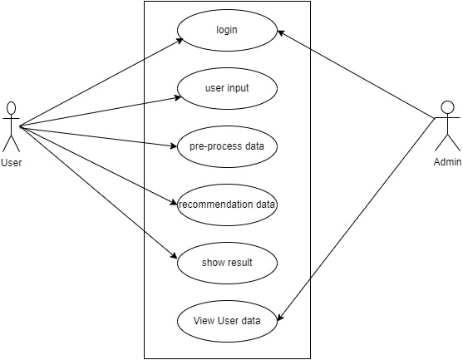
UML-Usecase Diagram

Slide 9
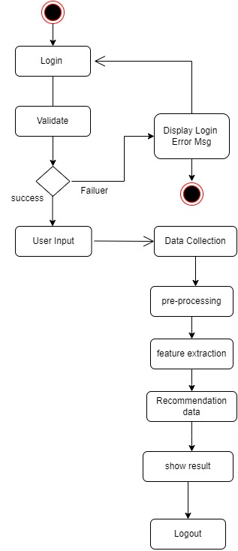
UML – Activity Diagram

Slide 10
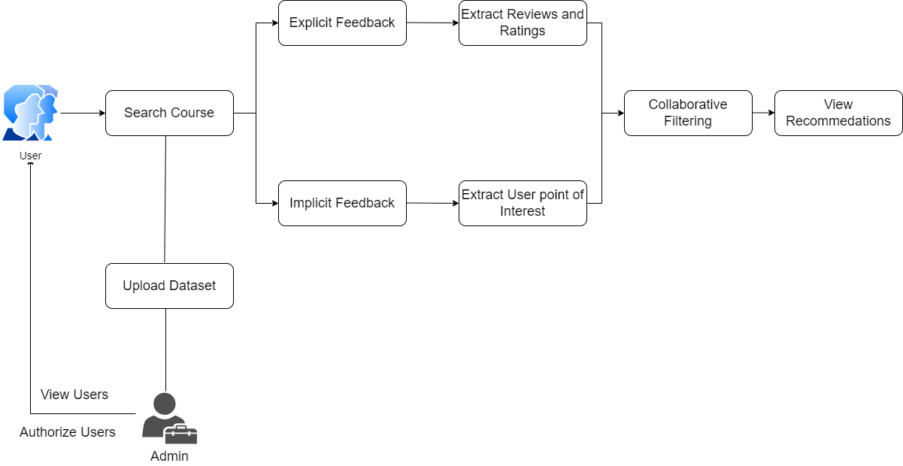
Detail Architecture

Slide 11
Component Design
Mouse
Keyboard
Laptop
Monitor
Hard-Disk

Slide 12

Data Flow Diagram – Level 0

Slide 13
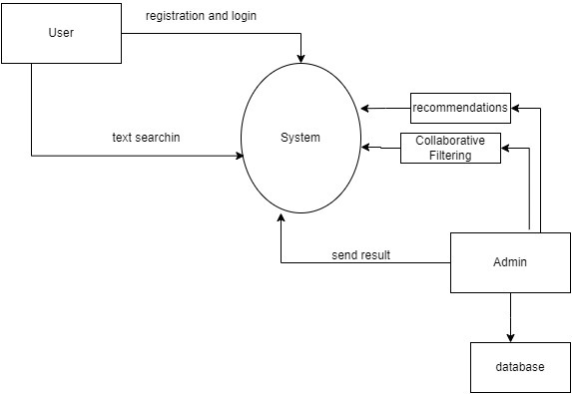
Data Flow Diagram – Level 1

Slide 14
Project Plan
Schedule |  | Date | Project Activity
July | 1stWeek | 01/07/2024 | Project Topic Searching
 | 2ndWeek | 08/07/2024 | Project Topic Selection
 | 3rd Week | 15/07/2024 | Synopsis Submission
August | 1stWeek | 05/08/2024 | Presentation On Project Ideas
 | 2ndWeek | 12/08/2024 | Submission Of Literature Survey
 | 3rd Week | 19/08/2024 | Feasibility Assessment
September | 1stWeek | 02/09/2024 | Documentation for paper publishing.
 | 3rdWeek | 16/09/2024 | Design Of Mathematical Model
 | 4thWeek | 24/09/2024 | Paper is publish.
October | 1stWeek | 09/10/2024 | Report Preparation And Submission
December | 3rdWeek | 19/12/2024 | 1stmodule presentation
 | 4thWeek | 26/12/2024 | Discussion and implementation of 2ndmodule
January | 1stWeek | 02/01/2025 | Preparation for conference
 | 2ndWeek | 09/01/2025 | Study of algorithm.
 | 3rdWeek | 16/01/2025 | Discussion about modification.
 | 4thWeek | 24/01/2025 | 1stand 2ndmodule presentation
 | 5thWeek | 30/01/2025 | Discussion on flow of project and designing new module
February | 1stWeek | 06/02/2025 | Modification of modules.
 | 2ndWeek | 13/02/2025 | Designed test cases for our module.
 | 3rdWeek | 20/02/2025 | Worked on user interface.
March | 1stWeek | 06/03/2025 | Integration of all modules.
April | 1stWeek | 8/04/2025 | Final Report.
May | 1stWeek | 10/05/2025 | Final Presentation.

Slide 15
THANK YOU!!!

